Slide 1
Hybrid systems

Slide 2
Neuro-Fuzzy Hybrid Systems
A neuro-fuzzy hybrid system (also called fuzzy neural hybrid), proposed by]. S. R. Jang, is a learning mechanism that utilizes the training and learning algorithms from neural networks to find parameters of a fuzzy system (i.e., fuzzy sets, fuzzy rules, fuzzy numbers, and so on).
It can also be defined as a fuzzy system that determines its parameters by processing data samples by using a learning algorithm derived from or inspired by neural network theory.
Alternately, it is a hybrid intelligent system that fuses artificial neural networks and fuzzy logic by combining the learning and connectionist structure of neural networks with human-like reasoning style of fuzzy systems.

Slide 3
widely termed as Fully Neural Network (FNN) or Neuro-Fuzzy System(NFS).
The human like reasoning style of fuzzy systems is incorporated by NFS (the more popular term is used henceforth) through the use of fuzzy sets and a linguistic model consisting of a set of lF-THEN fuzzy rules.
NFSs are universal approximators with the ability to solicit interpretable lF-THEN rules
However, the strength of NFSs involves intererpretabiliry versus accuracy, requiremems that are contradictory in fuzzy modeling.

Slide 4
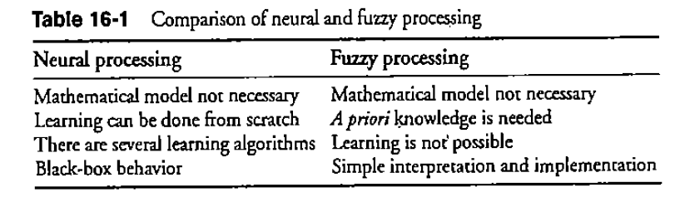
Comparison of Fuzzy Systems with Neural Networks

Slide 5
pattern recognition, regression, or density estimation
certain disadvantages are overcome by combining both concepts
When neural networks are concerned, if one problem is expressed by sufficient number of observed examples then only it can be used. These observations are used to train the black box.
Though no prior knowledge about the problem is needed extracting comprehensible rules from a neural network's structure is very difficult.

Slide 6
A fuzzy system, on the other hand, does not need learning examples as prior knowledge rather linguistic rules are required.
Moreover, linguistic description of the input and output variables should be given.
If the knowledge is incomplete, wrong or contradictory, then the fuzzy system must be tuned. This is a time consuming process.

Slide 7
Characteristics of Neuro-Fuzzy Hybrids
A fuzzy system-based NFS is trained by means of a data-driven learning method derived from neural network theory.
At any stage of the learning process- before, during, or after- it can be represented as a set of fuzzy rules.
For ensuring the semantic properties of the underlying fuzzy system, the learning procedure is constrained.

Slide 8
An NFS approximates an n-dimensional unknown function, partly represented by training examples.
Thus fuzzy rules can be interpreted as vague prototypes of the training data given by a three-layer feed-forward neural nerwork model.
It can also be observed that the first layer corresponds the input variables·, and the second and third layers correspond to the fuzzy rules and output variables, respectively. The fuzzy sets are converted to (fuzzy) connection weights.

Slide 9
NFS can also be considered as a system of fuzzy rules wherein the system can be initialized in the form of fuzzy rules based on the prior knowledge available.
Some researchers use five layers- the fuzzy sets being encoded in the units of the second and the fourth layer, respectively. It is, however, also possible for these models to be transformed into three-layer architecture.

Slide 10
In the field of fuzzy modeling research, the neuro-fuzzy is divided into two areas:
l. Linguistic fuzzy modeling focused on interpretability (mainly the Mamdani model).
2. Precise fuzzy modeling focused on accuracy [mainly the Takagi-Sugeno-Kang (TSK) model].

Slide 11
Classifications of Neuro·Fuzzy Hybrid Systems
Cooperative NFSs.
General neuro-fuzzy hybrid systems.

Slide 12
Cooperative Neural Fuzzy Systems
both artificial neural network (ANN) and fuzzy system work independently from each other.
The ANN attempts to learn the parameters from the fuzzy system.
Four different kinds…….

Slide 13
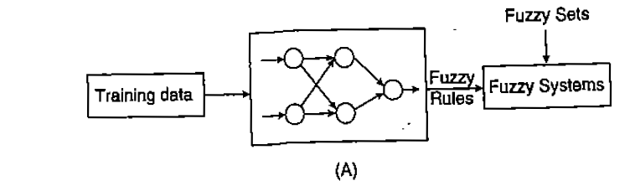
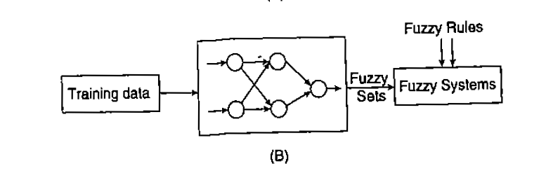

Slide 14
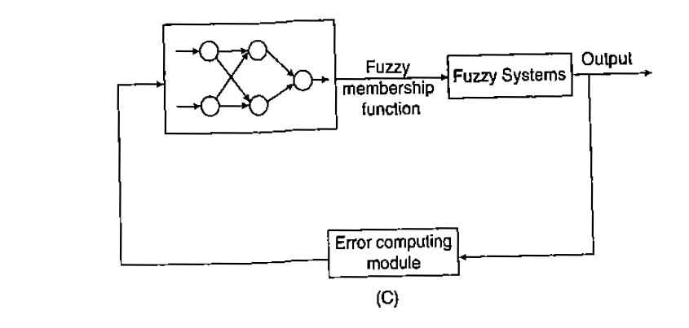
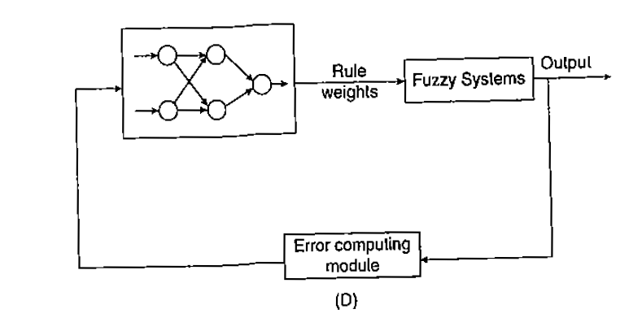

Slide 15
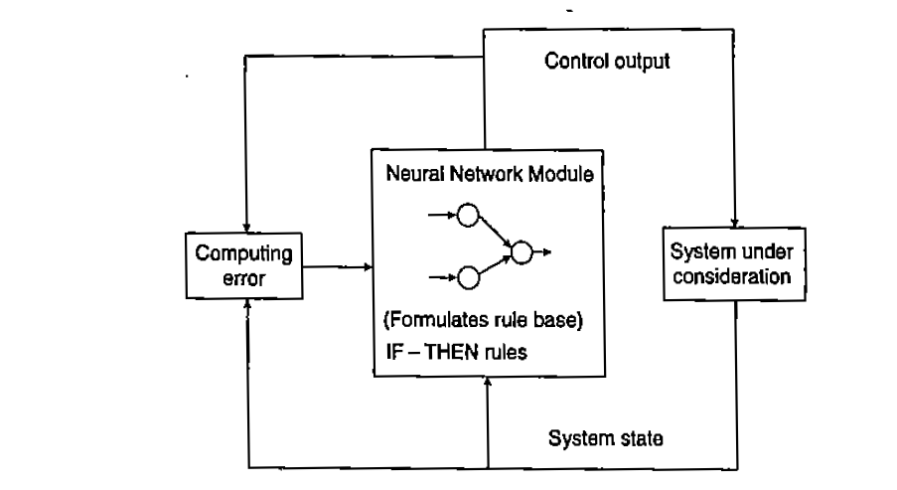
General Neuro·Fuzzy Hybrid Systems (General NFHS)
General neuro-fuzzy hybrid systems (NFHS) resemble neural networks where a fuzzy system is interpreted as a neural network of special kind.

Slide 16
The architecture of general NFHS gives it an advantage because there is no communication between fuzzy system and neural network.
The rule base of a fuzzy system is assumed to be a neural network;
the fuzzy sets are regarded as weights and
The rules and the input and output variables as neurons.
The choice to include or discard neurons can be made in the learning step.

Slide 17
Membership functions expressing the linguistic terms of the inference rules should be formulated for building a fuzzy controller. However, in fuzzy systems, no formal approach exists to define these functions.
Any shape, such as Gaussian or triangular or bell shaped or trapezoidal, can be considered as a membership with an arbitrary set of parameters.
Thus for fuzzy systems, the optimization of these functions in terms of generalizing the data is very important; this problem can be solved using neural networks.

Slide 18
The neuro fuzzy hybrid systems can also be modeled in an another method.
The training data is grouped into several clusters and each duster is designed to represent a particular rule.
These rules are defined by the crisp data points and are not defined linguistically.
Hence a neural network, in this case, might be applied to train the defined dusters.
The resting can be carried our by presenting a random resting sample to the trained neural network..
Each and every output unit will return a degree which extends to fit the antecedent of rule.

Slide 19
Genetic Fuzzy Rule Based Systems (GFRBSs)
For mechanizing the definition of the knowledge base of a fuzzy controller by GA have proven to be a powerful tool, since adaptive control, learning, and self-organization may be considered in a lot of cases as optimization or search processes.
for designing fuzzy controllers, in particular, the application to the design, learning and tuning of knowledge bases has produced quite good results.
In general these approaches can be termed as Genetic Fuzzy Systems (GFSs}.,
it is possible to distinguish between either parameter optimization or rule generation processes, that is, adaptation and learning.

Slide 20
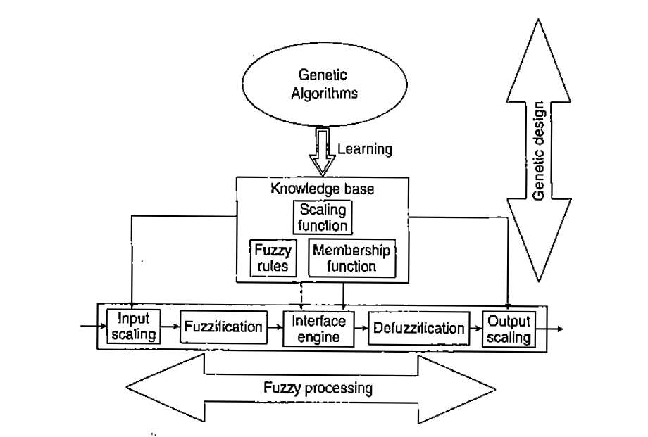

Slide 21
The main objectives of optimization in fuzzy rule based system are as follows:
The task of finding an appropriate knowledge base (KB) for a particular problem. This is equivalent to parameterizing the fuzzy KB (rules and membership functions).
To find those parameter values that are optimal with respect to the design criteria.

Slide 22
Considering a GFRBS, one has to decide which parts of the knowledge base (KB) are subject to optimization by the GA.
The KB of a fuzzy system is the union of qualitatively different components and not a homogeneous structure.
As an example, the KB of Mamdani-type fuzzy system has two components: rule base (RB) containing the collection of fuzzy rules and a data base {DB}, the definitions of the scaling factors and the membership functions of the fuzzy sets associated with the linguistic labels.
In this phase. it is important to distinguish between tuning {adaptation) and learning problems.

Slide 23
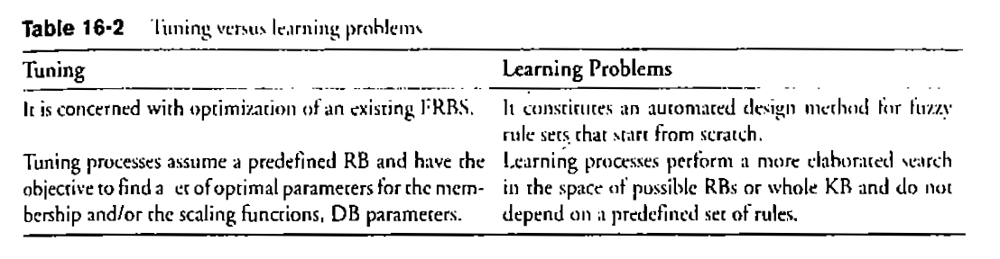

Slide 24
Genetic Tuning Process
The task of tuning the scaling functions and fuzzy membership functions are important in FRBS design.
The adoption of parameterised scaling functions,membership functions by the GA is based on the fitness function that specifies the design criteria quantitatively.
The responsibility rests with the tuning process which assume a predefined rule base.
The tuning process can he performed a priori also.
This can be done if a subsequent process derives the RB once the DB has been obtained, a priori generic DB learning.

Slide 25
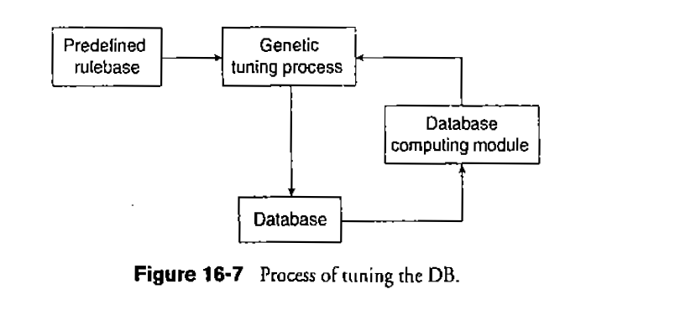

Slide 26
Tuning Scaling Functions
The universes of discourse where fuzzy membership functions are defined are normalized by scaling functions applied to the input and output variables of FRBSs.
In case of linear scaling. the scaling functions are parameterized by a single scaling factor or specifying a lower and upper bound.
in case of non-linear scaling, the scaling functions are paramte terized by one or several contraction /dilation parameters.
These parameters are adapted such that the scaled universe of discourses matches the underlying variable range.
This approach leads to a fixed length code as the number of variables is predefined as is the number of parameters required to code each scaling function.

Slide 27
Tuning Membership Functions
an individual represents the entire DB.
because its chromosome encodes the parameterized membership functions associated to the linguistic terms in every fuzzy partition considered by the fuzzy rule based system
Triangular (either isosceles asymmetric),Trapezoidal, or Gaussian functions are the most common shapes for membership function
descriptive (using linguistic variables) or the approximate (using fuzzy variables) type, the structure of the chromosome is different.

Slide 28
In the process of tuning the membership functions in a linguistic model, the entire fuzzy partitions are encoded into the chromosome and in order to maintain the global semantic in the RB, it is globally adapted.
These approaches usually consider a predefined number of linguistic terms for each variable -which leads to a code of fixed length in what concerns membership functions.
it is possible to evolve the number of linguistic terms associated to a variable;

Slide 29
Descriptive fuzzy systems working with strong fuzzy partitions, is a particular case where the number of parameters to be coded is reduced. Here, the number of parameters to code is reduced to the ones defining the core regions of the fuzzy set :the modal point for triangles and the extreme points of the core for trapezoidal shapes

Slide 30
Tuning the membership functions of a model working with fuzzy variables (scatter partitions), on the other hand, is a particular instance of knowledge base learning.
This is because, instead of referring to linguistic terms in the DB, the rules are defined completely by their own membership functions.

Slide 31
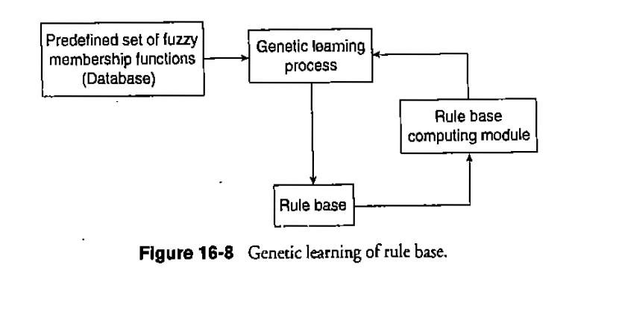
Genetic Learning of Rule Bases

Slide 32
focusing on learning rules, there are three main approaches
Pitsburgh approach.
Michigan approach.
Iterative rule learning approach.
The Pitsburgh approach is characterized by representing an entire rule ser as a generic code {chromosome), maintaining a population of candidate rule sets and using selection and generic operators to produce new generations of rule sets.
The Michigan approach where the members of the population are individual rules and a rule set is represented by the entire population.
In Iterative rule learning approach, the iterative one, chromosomes code individual rules, and a new rule is adapted and added to the rule set, in an iterative fashion, in every run of the genetic algorithm.

Slide 33
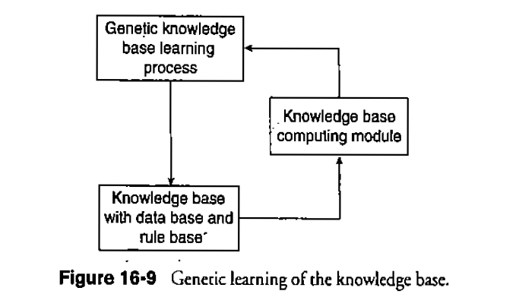
Genetic Learning of Knowledge Base

Slide 34
Genetic learning of a KB includes different genetic representations such as variable length chromosomes, multi-chromosome genomes and chromosomes encoding single rules instead of a whole KB as it deals with heterogeneous search spaces.
As t he complexity of the search space increases, the computational cost of the generic search also grows.
To combat this issue an option is to maintain a GFRBS that encodes individual rules rather than entire KB. In this manner one can maintain a flexible, complex rule space in which the search for a solution remains feasible and efficient.
The three learning approaches as used in case of rule base can also be considered here: Michigan, Pittsburgh, and iterative rule learning approach.

Slide 35
Advantages of Genetic Fuzzy Hybrids
The hybridization between fuzzy systems and GAs in GFSs became an important research area during the last decade.
GAs allow us to represent different kinds of structures, such as weights, features together with rule parameters, ere., allowing us to code multiple models of knowledge representation.
This provides a wide variety of approaches where it is necessary to design specific generic components for evolving a specific representation.
Generic algorithm efficiently optimizes the rules, membership functions, DB and KB of fuzzy systems.
The methodology adopted is simple and the fittest individual is identified during the process.

Slide 36
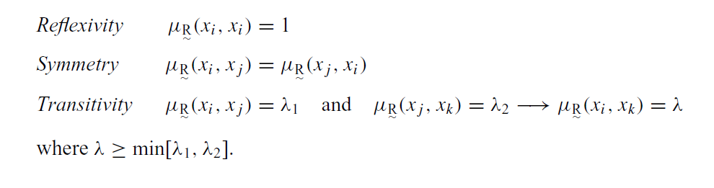
FUZZY TOLERANCE AND EQUIVALENCE RELATIONS

Slide 37

It can be shown that any fuzzy tolerance relation,R , that has properties of reflexivity and symmetry can be reformed into a fuzzy equivalence relation by at most (n − 1) compositions, just as a crisp tolerance relation can be reformed into a crisp equivalence relation.

Slide 38
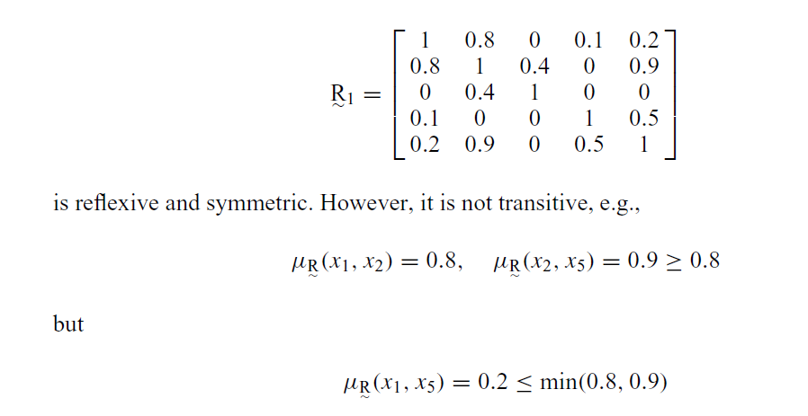

Slide 39
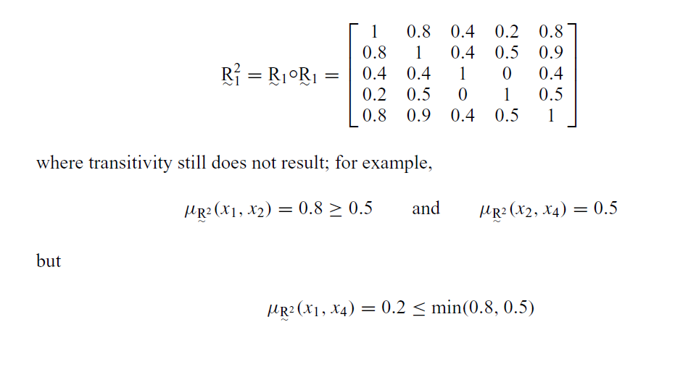

Slide 40
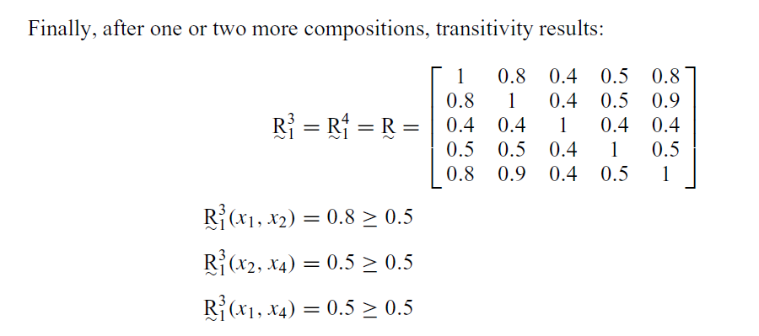

Slide 41
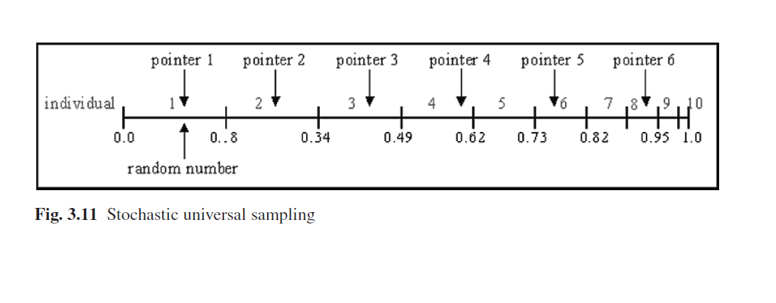
Stochastic universal sampling

